Slide 1

Incident management and response Introduction and Methods
Joakim Kävrestad Jönköping School of Engineering joakim.kavrestad@ju.se
© Crown Copyright, The National Cyber Security Centre 2023. This information is licensed under the Open Government Licence v3.0. To view this licence, visit https://www.nationalarchives.gov.uk/doc/open-government-licence/version/3/.
When you use this information under the Open Government Licence, you should include the following attribution: CyBOK Incident management and response Introduction and Methods slides © Crown Copyright, The National Cyber Security Centre 2023, licensed under the Open Government Licence: https://www.nationalarchives.gov.uk/doc/open-government-licence/version/3/.

Slide 2
Literature note
This lecture is based on the following CyBOK knowledge areas:
Security Operations and Incident Management
Additional material is cited throughout the lecture

Slide 3
Agenda
Security operations and incident management (SOIM) at a glance
Incidents?!
Handling the incidents!

Slide 4
SOIM
Security Operations and Incident Response (SOIM)
Assumes that we can't, or won’t fully protect our cyber environment
Consequently, we acknowledge that there will be incidents
SOIM can be described as the processes and capabilities for handling that reality
Why don’t we want to be fully secure?
Security vs Usability
Financial reasons
Also, we can't

Slide 5
SOIM – MAPE-K
SOIM can be seen as an application of the MAPE-K model for cybersecurity
Monitor, Analyze, Plan, Execute – Knowledge (MAPE-K)
MAPE-K is an architecture for adaptive systems
An event-driven loop
Events, or the result of events, provide feedback to the system
Feedback is used to change the system behavior

Slide 6
SOIM – MAPE-K

Slide 7
REFLECT!
Use one minute to write down one-liners that describe what you just learned – come up with as many as you can.
Join up in pairs or groups and compare your lists for another minute.
Questions so far?

Slide 8
SOIM – MAPE-K
SOIM workflows
Intrusion detection and prevention systems (IDPS)
Security Information and Event Management (SIEM)
Security Orchestration, Automation, and Response (SOAR)
MAPE-K components
Monitor (IDPS)
Analyze (IDPS and SIEM)
Plan (SIEM and SOAR)
Execute (SOAR)

Slide 9
SOIM – The K
SOIM requires knowledge and updated knowledge
Several sources
Threat intel
Assets
Staff
….
Event-driven so that events are taken through the loop and then generate new knowledge for the loop

Slide 10
SOIM – Architectural principles
SOIM assumes that there is some system that needs protection
SOIM tools and processes are deployed in that system
It is common practice to segment the system, for instance using DMZ and private networks

Slide 11
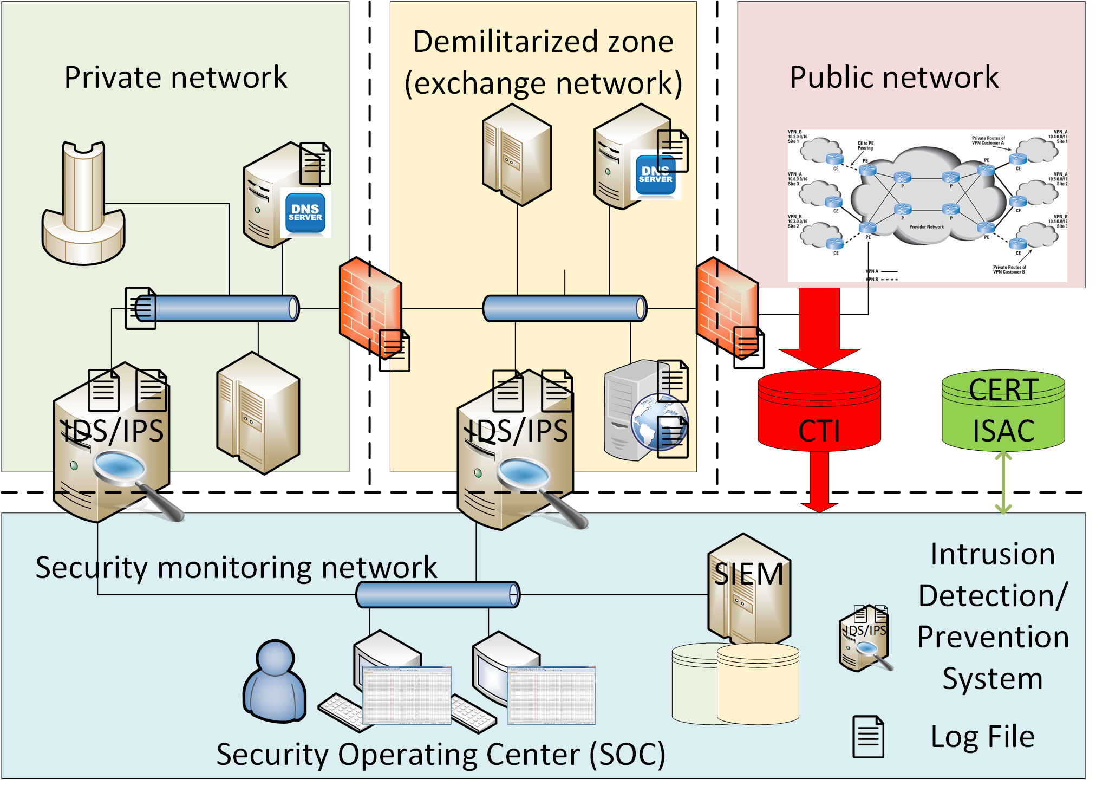
SOIM – Architectural principles

Slide 12
SOIM – Knowledge
Knowledge mainly refers to intelligence and analytics
CTI – Cyber threat intelligence
ISAC – Information Sharing and Analysis Centers
CTI
Detailed knowledge of threats against an organization
ISAC
Organizations that gather data on cyber threats

Slide 13
SOIM – Knowledge management
Maintaining an internal knowledge base is crucial for the ability to cross-reference system events with known intel
Many open and commercial databases are available
CVE
Mitre ATT&CK
….

Slide 14
SOIM – Honeypots
A system or set of systems offered as bait to attackers
Purpose is to present decoy machines that attackers will attack and monitor what happens
Learn about attacker techniques
Learn who the attackers are
A way to gather own intel

Slide 15
SOIM – CTI
Information and signature sharing
Sharing intel and signatures for different platforms
Malware Information Sharing Platform
SNORT rule sets
YARA signature exchange
Indicators of Compromise (IoC)
Indicators of incidents, broadly speaking
Several standards for sharing

Slide 16
SOIM – Situational awareness
Awareness of any kind of suspicious or interesting activity taking place in cyberspace
Cyber threats are evolving and ever-changing
Adaption to current trends helps defense
Includes reports from official bodies such as ENISA, the European agency for cyber security

Slide 17
REFLECT!
Use one minute to write down one-liners that describe what you just learned – come up with as many as you can.
Join up in pairs or groups and compare your lists for another minute.
Questions so far?

Slide 18
Incident handling
Security operations
Avoiding bad events as far as possible (feasible)
Detecting bad events when they occur
Handling them when they occur
Incident = bad/unwanted/abnormal event
A response process is initiated on suspicion of an incident

Slide 19
Incident Response
We now operate with an assume compromise set of mind
Incidents will happen
We just don't know when
When an incident occurs, we need to minimize its impact by following an incident response plan
Incident response is basically about managing incidents and includes the practices of responding to identified incidents

Slide 20
Incident Response – why?
We know about the threat landscape by now
Script kiddies
Malware on the loose
Hacktivists
Pranksters
Organized crime
APT/state-sponsored actors
Staying safe is not a choice for many organizations, it’s a requirement

Slide 21
Incident Response – why?
Being targeted by an attacker can lead to extreme losses for an organization
Leaks
Ransomware
…..
Being able to respond to an incident in a proper way is a core business function
MAERSK(Not-Petya) vs Voice integrate (1177)
Impressed the IT world vs complete loss of trust and loss of business

Slide 22
Incident Response – how?
Roughly divided into two tasks:
Establishing capabilities
Incident handling
Literature
CyBOK
Incident handler's handbook (SANS)
Guide to integrating forensic techniques into incident response. NIST Spec Publ 10:800–886

Slide 23
Incident Response – Establishing capabilities
The task of getting ready
An incident is a stressful situation
Loss of production
Media attention
Legal actions
Being well prepared makes you know how to act and what to do
Note that we should consider incidents as something that WILL happen rather than something that can happen

Slide 24
Incident Response – Establishing capabilities
Create a Computer Security Incident Response Team (CSIRT)
Technical staff
Legal expertise
Public relations
HR
Develop policies and procedures that describe what to do how, and who
Ensure access to relevant resources
Training, training, training

Slide 25
Incident Response – Establishing capabilities
The policy should outline the rules for incident response work
Content to include:
What an incident is
Incident classification and how various incidents should be handled
CSIRT contact list
Members and their contact info
Contingency plan
Prioritization
Communication plan
Who to talk to and when
Resources that the CSIRT can use and allocate

Slide 26
Incident Response – Establishing capabilities
Resources need to be easily available and can include
The policy
Important tools (more is more in this case)
Backup internet connection
Backup and recovery plans
Empty removable storage
Backup power
Backup peripherals
Backup laptop with tools
Evidence-gathering gear

Slide 27
Incident Response – Handling
Analysis
Mitigation
Communication

Slide 28
Incident Response – Handling - Analysis
Investigate the incident
Type
Scope
This is a difficult task that aims to understand the nature of the incident and the (potential) damage caused

Slide 29
Incident Response – Handling - Mitigation
Focus on containing the incident
Isolate infected hosts
Isolate hosts critical to the organization
Actual task depends on the nature of the incident
Cutting the network
Applying security patches
Reinstalling machines
Shutting down services
…
Analysis and mitigation are often iterative phases

Slide 30
Incident Response – Handling - Communication
Communication is important for several reasons
Legal and compliance
Warn others
Maintain trust, both internally and externally
NOTE! As a community, we need to create a climate where we can talk and share. We need to stop shaming attack victims!

Slide 31
Incident Response – Post
Return to normal operation
Purge the incident from the system
Post-incident activities
Measure the performance of the incident handling and learn from that
Legal aftermath
Communication
Possible long-term business impacts

Slide 32
REFLECT!
Use one minute to write down one-liners that describe what you just learned – come up with as many as you can.
Join up in pairs or groups and compare your lists for another minute.
Questions so far?

Slide 33
Thank you for today!

